Slide 1
Winnowing: Local Algorithms for Document Fingerprinting
Saul Schleimer
MSCS
University of Illinois, Chicago
Daniel S. Wilkerson
Computer Science Division
UC Berkeley
Alex Aiken
Computer Science Division
UC Berkeley
SIGMOD 2003, June 9-12, San Diego, CA.
Notes:
聖地牙哥加利福尼亞大學（英语：University of California, San Diego

Slide 2
Outline
Introduction
Background and related work
Winnowing
Local Algorithm
Experiments
Conclusions
Notes:
http://fcrh.logdown.com/posts/592025-about-rolling-hash (roliing hash)
https://www.csie.ntu.edu.tw/~hsinmu/courses/_media/dsa_13spring/string_matching.pdf (karp-rabin string matching)

Slide 3
Introduction (1/4)
Digital content is for copying: quotation, revision, plagiarism, and file sharing all create copies.
Document fingerprinting is concerned with accurately identifying copying, including small partial copies, within large sets of documents.
Comparing whole document checksums is simple and suffices for reliably detecting exact copies; however, detecting partial copies is subtler. Because of its many potential applications, this second problem has received considerable attention.
Notes:
引用,修訂,抄襲
數位文件基於很多種理由廣泛被大眾所複製: 如引用新聞或信件; 共同研究者創在多個版本的文件,每個版本都很接近上個版本; 學生從網路抄作業; conference paper作者也常如此, 指示是在可接受的範圍格式下reuse; 很多商業模式也是會將數位資訊複製販賣, 像是軟體或娛樂產業
Subtle精妙的; 精湛的; 巧妙的

Slide 4
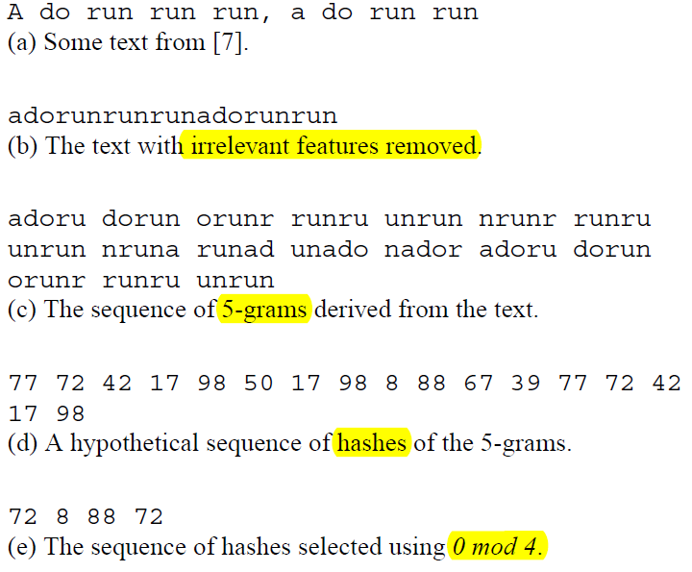
Introduction (2/4)
Most previous techniques for detecting partial copies, which we discuss in more detail in Section 2, make use of the following idea.
For efficiency, only a subset of the hashes should retained as the document’s fingerprints. -> 0 mod p, for some fixed p.
Notes:
A fingerprint also contains positional information, which we do not show, describing the document and the location within that document that the fingerprint came from.
If the hash function is chosen so that the probability of collisions is very small, then whenever two documents share one or more fingerprints, it is extremely likely that they share a k-gram as well.
This approach is easy to implement and retains only 1/p of all hashes as fingerprints

Slide 5
Introduction (3/4)
Meaningful measures of document similarity can also be derived from the number of fingerprints shared between document.
A disadvantage of this method is that it gives no guarantee that matches between documents are detected.
If fingerprints are selected 0 mod p, the maximum gap between two fingerprints is unbounded and any matches inside a gap are not detected. (Call the distance between consecutive selected fingerprints the gap between them.)
Notes:
具有意義的測量文件的相似度, 也可透過取得 doc. 間 share 的 finger. 作為依據

Slide 6
Introduction (4/4)
In this paper we give the first efficient algorithm for selecting the fingerprints from a sequence of hashes that guarantees that at least part of any sufficiently long match is detected.
We introduce the class of local document fingerprinting algorithms, which seems to capture an essential property of any fingerprinting technique guaranteed to detect copies.
We prove a novel lower bound on the performance of any local algorithm.
We also develop winnowing, an efficient local fingerprinting algorithm, and show that winnowing’s performance is within 33% of the lower bound.
Notes:
證明至少一部份的任何有效長度的 match可被偵測

Slide 7
Outline
Introduction
Background and related work
Winnowing
Local Algorithm
Experiments
Conclusions
Notes:
http://fcrh.logdown.com/posts/592025-about-rolling-hash (roliing hash)
https://www.csie.ntu.edu.tw/~hsinmu/courses/_media/dsa_13spring/string_matching.pdf (karp-rabin string matching)

Slide 8
Background and related work
Not all copy-detection algorithms are based on selecting fingerprints of k-grams.
To give some basis for discussing different techniques, we list several criteria that a copy-detection algorithm should satisfy.
These requirements are based on our own experience, but echo many of the goals outlined in papers on related techniques.
A copy-detection algorithm should have three properties:
Whitespace insensitivity Matches should be unaffected by such things as extra whitespace, capitalization, punctuation, etc.
Noise suppression Discovering short matches is uninteresting
Position independence Coarse-grained permutation of the contents of a document should not affect the set of discovered matches.
Notes:
In other domains the notion of what strings should be equal is different 也可用在別的領域 如: 程式中的變數名稱不重要 For example, whitespace &punctuation are removed, lowercase ,all variable names are replaced by the identifier “V”.
Any match must be large enough to imply that the material has been copied and is not simply a common word or idiom of the language in which documents are written. choosing k to be sufficiently long that common idioms of the language have length shorter than k
scrambling the order of paragraphs 最後在介紹3的解決方法前, 先簡單介紹 使用k-grams的hashes 作為in copy detection (use of hashes of k-grams ) 的歷史

Slide 9
Background and related work
Karp-Rabin String Matching (1/2)
It for fast substring matching is apparently the earliest version of fingerprinting based on k-grams.
Their problem, which was motivated by string matching problems in genetics, is to find occurrences of a particular string s of length k within a much longer string.
The idea is to compare hashes of all k-grams in the long string with a hash of s.
However, hashing strings of length k is expensive for large k, so they propose a “rolling” hash function.

Slide 10
Background and related work
Karp-Rabin String Matching - a “rolling” hash function. (2/2)
Treat a k-gram c₁ . . . c_{k} as a k-digit number in some base b.
The hash H(c₁ . . . c_{k}) of c1 . . . ck is this number:
To compute the hash of the k-gram c2 . . . ck+1, we need only subtract out the high-order digit, multiply by b, and add in the new low order digit.
A weakness: because the values of the c_{i} are relatively small integers, doing the addition last means that the last character only affects a few of the low-order bits of the hash.

Slide 11
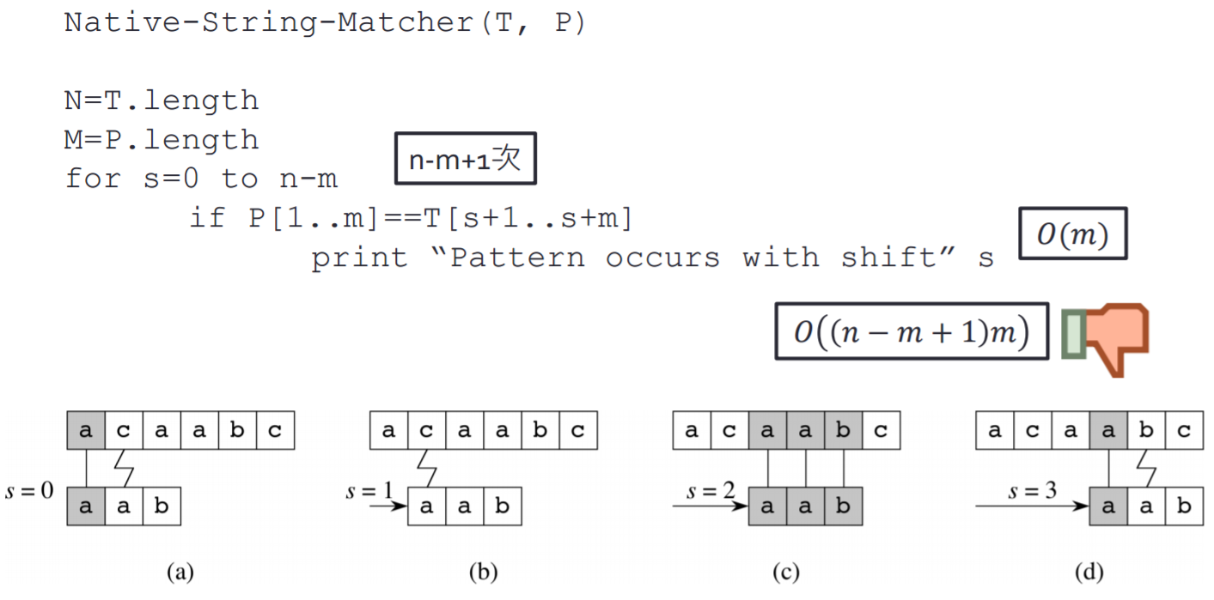
Time complexity of 暴力法
Notes:
http://fcrh.logdown.com/posts/592025-about-rolling-hash (roliing hash)
https://www.csie.ntu.edu.tw/~hsinmu/courses/_media/dsa_13spring/string_matching.pdf (karp-rabin string matching)

Slide 12

Time complexity of Karp-Rabin String Matching
Pattern (the m length of sub strings) = P₁ b^{m-1} + P₂ b^{m-2} + …. + P_{m-1} b¹ + P_{m}
The n^{st} m-gram in text
t₀ = T₁ b^{m-1} + T₂ b^{m-2} + …. + T_{m-1} b¹ + T_{m}
t₁ = T₂ b^{m-1} + T₃ b^{m-2} + …. + T_{1+(m-1)} b¹ + T_{1+m}
…..
t_{n} = T_{n+1} b^{m-1} + T_{n+2} b^{m-2} + …. + T_{n+(m-1)} b¹ + T_{n+m}
共: 𝑂(𝑚) preprocessing時間, 𝑂(𝑛 − 𝑚)比對時間 >> 𝑂(( 𝑛 − 𝑚 + 1 )*m)

Slide 13
Background and related work
All-to-all matching (1/4)
The first scheme to apply fingerprinting to collections of documents was developed by Manber, who apparently independently discovered Karp-Rabin string matching and applied it to detecting similar files in file systems [12].
Rather than having a single candidate string to search for, we wish to compare all pairs of k-grams in the collection of documents.
The all-to-all nature of this comparison is a key difficulty in document fingerprinting.
A naive scheme that selected all hashed k-grams would create an index much larger than the original documents. -> select some subset of the hashes to represent each document.
Notes:
apparently 顯然地，似乎

Slide 14
Background and related work
All-to-all matching (2/4)
But which hashes should be selected as fingerprints?
A simple but incorrect strategy is to select every i ^{th} hash of a document -> not robust against reordering, insertions and deletions (Position independence) -> Thus, any effective algorithm for choosing the fingerprints can’t rely on the position of the fingerprints within the document.
The scheme Manber chose is to select all hashes that are 0 mod p and found this technique worked well. (satisfy Position independence)
Notes:
In fact, prepending one character to a file shifts the positions of all k-grams by one, which means the modified file shares none of its fingerprints with the original.

Slide 15
Background and related work
All-to-all matching (3/4)
But which hashes should be selected as fingerprints?
Heintze proposed choosing the n smallest hashes of all k-grams of a document as the fingerprints of that document.
By fixing the number of hashes per document, the system would be more scalable as large documents have the same number of fingerprints as small documents.
This idea was later used to show that it was possible to cluster documents on the Web by similarity [6].
The price for a fixed-size fingerprint set is that only near-copies of entire documents could be detected

Slide 16
Background and related work
All-to-all matching (4/4)
Heintze proposed choosing the n smallest hashes of all k-grams of a document as the fingerprints of that document.
Documents of vastly different size could not be meaningfully compared.
ex: the fingerprints of a paragraph would probably contain no fingerprints of the book that the paragraph came from.
0 mod p -> generates variable size sets of fingerprints for documents but guarantees that all representative fingerprints for a paragraph would also be selected for the book.
Broder [5] classifies these two different approaches to fingerprinting as being able to detect only resemblance between documents or also being able to detect containment between documents.
Notes:
3.3 Documents of vastly different size could not be meaningfully compared; for example, the fingerprints of a paragraph would probably contain no fingerprints of the book that the paragraph came from.
只能表示部分的doc, 不向 0 mod p, 可以有多種不同的表示 (variable size sets of fingerprints for documents but guarantees that all representative fingerprints for a paragraph would also be selected for the book.)

Slide 17
Background and related work
Other techniques (1/4)
Instead of using k-grams, the strings to fingerprint can be chosen by looking for sentences or paragraphs, or by choosing fixed-length strings that begin with “anchor” words.
Early versions of our system also used structure gleaned from the document to select substrings to fingerprint. However, the is that the implementation becomes rather specific to a particular type of data.
In our experience, using k-grams as the unit of hashing is much more robust than relying on common-case assumptions about the frequency of specific structure in the input.
Notes:
with “anchor” words. - link label or link title

Slide 18
Background and related work
Other techniques (2/4)
There are approaches to copy detection not based on fingerprinting.
In SCAM, a well-known copy-detection system, one of the ideas that is explored is that two documents are similar if the distance between feature vectors representing the two documents is small.
The features are words, and the notion of distance is a variation on standard information-retrieval measures of similarity [14].
Baker considers the problem of finding near-duplication in software and develops the notion of parameterized matches, or p-matches
Consider two strings, some letters of which are designated as parameters.
The strings match if there is a renaming of parameters that makes the two strings equal.
He gives an algorithm for computing p-matches and reports on experience with an implementation in [2] and in a subsequent paper considers how to integrate these ideas with matching on k-grams [3].

Slide 19
Background and related work
Other techniques (3/4)
There is an important distinction to be made between copy-detection for discrete data and for continuous data.
discrete data (ex: text files and program source)
after a simple suppression of the uninteresting pieces of documents, exact matching on substrings of the remainder is a useful notion.
continuous data (ex: audio, video, and images)
there have been a number of commercial copy-detection systems built but relatively little has been published in the open literature.
The problems here are more difficult, because very similar copies of images, for example, may have completely different bit representations.
Notes:
notion概念

Slide 20
Background and related work
Other techniques (4/4)
Further afield from copy-detection, but still related, is Digital Rights Management (DRM).
DRM systems seek to solve the problem of the use of intellectual property by preventing or controlling copying of documents.
DRM schemes are encryption-based.
However, regardless of the copy-prevention technology chosen, users must ultimately have access to the unencrypted data.
We find ourselves in agreement with [4]: for at least some forms of digital media copy-prevention systems will have trouble ultimately succeeding. We suspect that in many environments the best one can hope for is efficient copy detection.

Slide 21
Outline
Introduction
Background and related work
Winnowing
Local Algorithm
Experiments
Conclusions

Slide 22
Winnowing
Winnowing
Expected Density
Queries
Notes:
Density 密度

Slide 23
a) Winnowing (1/6)
In this section we describe and analyze the winnowing algorithm for selecting fingerprints from hashes of k-grams.
We give an upper bound on the performance of winnowing, expressed as a trade-off between the number of fingerprints that must be selected and the shortest match that we are guaranteed to detect.
Given a set of documents, we want the find substring matches between them that satisfy two properties:
If there is a substring match at least as long as the guarantee threshold, t, then this match is detected, and
We do not detect any matches shorter than the noise threshold, k.
Notes:
必須要選擇的 fingerprints 數量
可以偵測到的最短match
權衡
在一群文件的集合下, 我們想要找到他們間的substring matches , 滿足以下兩個特性
若一個 substring match 長度大於 guarantee threshold t, 就一定會被偵測到
且不偵測任何長度小於 noise threshold, k 的 substring match.

Slide 24
a) Winnowing (2/6)
The constants t and k ≤ t are chosen by the user.
it is important to choose k to be the minimum value that eliminates coincidental matches (see Section 5)
The larger k is, the more confident we can be that matches between documents are not coincidental.
The larger k also limits the sensitivity to reordering of document contents, as we cannot detect the relocation of any substring of length less than k.
Notes:
必須要選擇的 fingerprints 數量
可以偵測到的最短match
在一群文件的集合下, 我們想要找到他們間的substring matches , 滿足以下兩個特性
若一個 substring match 長度大於 guarantee threshold t, 就一定會被偵測到
且不偵測任何長度小於 noise threshold, k 的 substring match.

Slide 25
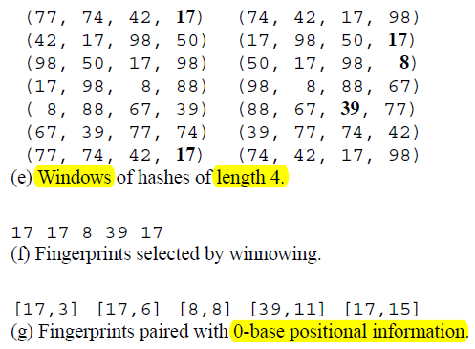
a) 0 mod p VS. winnowing (3/6)
0 mod p
winnowing

Slide 26
a) Winnowing (4/6)
Given a sequence of hashes h₁ . . . h_{n}, if n > t − k, then at least one of the h_{i} must be chosen to guarantee detection of all matches of length at least t.
This suggests the following simple approach:
Let the window size be w = t − k + 1.
Consider the sequence of hashes h₁ h₂ . . . h_{n} that represents a document.
Each position 1 ≤ i ≤ n − w + 1 in this sequence defines a window of hashes h_{i} . . . h_{i+w-1}.
To maintain the guarantee it is necessary to select one hash value from every window to be a fingerprint of the document.
We have found the following strategy works well in practice.
Notes:
假設一個 hash seq. 是 h1-hn, 則至少有一個 hi 會被選到, 來證明所有 match的長度至少> t
相當於一個 window 表示一個字串t (下頁之後會說)
一個 hash seq. 是 h1-hn代表一個 doc.
一個 window -> hi~hi+w-1
需要在每個widow選一個 hash 作為 fingerprint

Slide 27
a) Winnowing (5/6)
DEFINITION1 (WINNOWING). In each window select the minimum hash value. If there is more than one hash with the minimum value, select the rightmost occurrence. Now save all selected hashes as the fingerprints of the document.
The intuition behind choosing the minimum hash is that the minimum hash in one window is very likely to remain the minimum hash in adjacent windows.
Thus, many overlapping windows select the same hash, and the number of fingerprints selected is far smaller than the number of windows while still maintaining the guarantee.
Notes:
, since the odds are that the minimum of w random numbers is smaller than one additional random number

Slide 28
a) Winnowing (6/6)
In many applications it is useful to record not only the fingerprints of a document, but also the position of the fingerprints in the document.
Figure 2(f) shows the set of [fingerprint, position] pairs for this example (the first position is numbered 0).

Slide 29
Winnowing
Winnowing
Expected Density
Queries

Slide 30
b) Expected Density (1/7)
Recall that the density of a fingerprinting algorithm is the expected fraction of fingerprints selected from among all the hash values computed, given random input.
We now analyze the density of winnowing, which gives the trade-off between the guarantee threshold and the number of fingerprints required.
Consider the function C that maps the position of each selected fingerprint to the position of the first (leftmost) window that selected it in the sequence of all windows for a document. - The charge function is monotonic increasing — if p and q are the positions of two selected fingerprints and p < q, then C(p) < C(q).
We assume that the space of hash values is very large so that we can safely ignore the possibility that there is a tie for the minimum value for any small window size.
Notes:
演算法的 density 指在隨機input下, 期望從所有 hash value 挑出的 fingerprints部分
希望能在 the guarantee threshold 和 需要的 fingerprints 數量間達到平衡

Slide 31
b) Expected Density (2/7)
Consider an indicator random variable X_{i} that is one iff the i^{th} window W_{i} is charged.
Consider the adjacent window to the left W_{i-1}.
The two intervals overlap except at the leftmost and rightmost positions.
Their union is an interval of length w+1.
Consider the position p containing the smallest hash in that union interval. Any window that includes p selects h_{p} as a fingerprint.

Slide 32
b) Expected Density (3/7)
There are three cases:
If p = i − 1, the leftmost position in the union, then W_{i-1} selects it. Since p ∉ W_{i}, we know W_{i} must select a hash in another position, q. This hash is charged to W_{i} since W_{i} selected it, W_{i−1} didn’t select it, and the charge function is monotonic increasing. Thus in this case, X_{i} = 1.
If p = i+w−1, the rightmost position in the union interval, then Wi selects it. Again, Xi = 1.
If p is in any other position in the union interval, both W_{i−1} and W_{i} select it. No matter who is charged for it, it won’t be W_{i}, since W_{i−1} is further left and also selected it. Thus in this case, X_{i} = 0.
The first two cases happen with probability 1 / (w + 1), and so the expected value of X_{i} is 2 / (w + 1).
Recall that the sum of the expected values is the expected value of the sum, even if the random variables are not independent. Thus the density is d = 2 / (w + 1).

Slide 33

b) Expected Density (4/7)
Comparison to 0 mod p at same density
That is, we take p = 1/d = (w + 1)/2.
For a string of length t = w + k − 1 consider the event that the 0 mod p algorithm fails to select any fingerprint at all within it. (Recall that winnowing would never fail to do so.)
We now compute the probability of this event for one given string. - Please note that for two overlapping such strings these events are not independent. Thus the probability we compute is not a good estimate.
We assume independent uniformly distributed hash values and also assume large w; in our experiments w = 100.
Thus, the probability that the guarantee fails in a given sequence of text of length t (that no hash in a given sequence of w hashes is 0 mod p)
Notes:
在相同 density 0 mod p fails to select any fingerprint 的機率
(演算法的 density 指在隨機input下, 期望從所有 hash value 挑出的 fingerprints部分)
Density 相同 guarantee的保證率 ?

Slide 34
b) Expected Density (5/7)
Comparison to 0 mod p with guarantee
One may be tempted to try modifying the 0 mod p algorithm to give a guarantee.
There is one straightforward solution that we know of: In the event that a gap longer than the guarantee threshold threatens to open up, select all hashes as fingerprints until the next hash that is 0 mod p.
Let the Safe 0 mod p algorithm be as follows. Partition hashes into:
Good if a hash is 0 mod p.
Bad if it and the w − 1 hashes to its left are not Good, and
Ugly otherwise [11].
Select all non-Ugly hashes as fingerprints. (in Section 4, this algorithm is local and is therefore correct.)
Note that we have chosen the parameters so that the guarantee t is the same as that of winnowing. All that remains is to compute the optimal expected density.
Notes:
Guarantee相同, 0 mod p 的 expected density

Slide 35
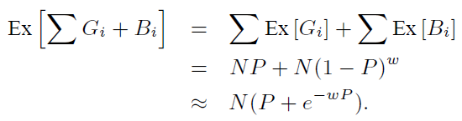
b) Expected Density (6/7)
Comparison to 0 mod p with guarantee
Fix a document and consider a position i.
Let G_{i} and B_{i} denote the events that the hash at i is good or bad.
Let P = 1/p. (Note that to compete with winnowing we would need P to be rather small: P ≤ 2/(w + 1); however even a slightly larger P will allow for the 1+x ≈ e^{x} approximation we use below.)
We have Pr[G_{i}] = P and for small P : Pr[B_{i}] = (1 − P)^{w} ≈ e^{−wP} .
The expected value of a sum is the sum of the expected values.
We have that the expected value of the non-ugliness of a position is

Slide 36






b) Expected Density (7/7)
Comparison to 0 mod p with guarantee
The next step is to minimize the density. Let
Setting and solving we have or
We check that so we have found the global
minimum. If we use this optimal value, P₀, the Safe 0 mod p algorithm has density at least
which is considerably more than that of winnowing: 2/ (w + 1).

Slide 37
Winnowing
Winnowing
Expected Density
Queries

Slide 38
c) Queries (1/2)
This section is primarily about how to choose hashes well, but we digress a bit here to discuss how hashes can be used once selected.
In a typical application, one first builds a database of fingerprints and then queries the fingerprints of individual documents against this database.
Winnowing gives us some flexibility to treat the two fingerprinting times (database-build time and query time) differently.
Consider a database of fingerprints (obtained from k-grams) generated by winnowing documents with window size w. Now, query documents can be fingerprinted using a different window size.
The advantage of winnowing query documents with a window size w’ ≥ w is that F_{w’} ⊆ F_{w}, which means fewer memory or disk accesses to look up fingerprints.
F_{w} be the set of fingerprints chosen for a document by winnowing with window size w.
Notes:
Digress 離題

Slide 39
c) Queries (2/2)
Fingerprint a query document with the same window w used to generate the database, and then sort all of the selected fingerprints in ascending order.
look up some number of the fingerprints in the database, starting with the smallest.
If we stop after a few, fixed number of hashes, we have realized Broder’s and Heintze’s approach for testing document resemblance [8, 5].
If we use all of the hashes as fingerprints, we realize the standard notion of testing for document containment.
There is also a spectrum where we stop anywhere in between these two extremes. Broder’s paper on resemblance and containment gives distinct algorithms to compute these two properties [5]; winnowing naturally realizes both.
Notes:
Spectrum系列；範圍；幅度

Slide 40
Outline
Introduction
Background and related work
Winnowing
Local Algorithm
Experiments
Conclusions

